Slide 1
Welcome to Open House Algebra I T. H. Rogers School
September, 21 2022

Slide 2
Agenda
Introduction.
Curriculum.
Resources
Grading Policy
Late Work Policy
Progress Report
Contact Information & Communication
Q & A

Slide 3
Introduction
This is my 9th year teaching math.
I taught Geometry for 2 years at memorial high school .
I taught math 7, algebra I, and geometry for last 6 years at T.H. Rogers.

Slide 4
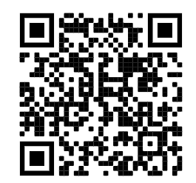
Curriculum Goals
Algebra I is the high school credit course and is the foundation of high school mathematic courses.
We follow HISD’s curriculum which is aligned with TEKS.
Class syllabus

Slide 5
Resources
Carnegie Learning
Carnegie Book
Online access
Hard copy
Mathia
Study Island
R 360

Slide 6
Grading Policy
Learning (70%)
Homework
Quiz
Class-works
Assessment (30%)
Test
Project

Slide 7
Late Work Policy
Missing assignment 10% off
14 days to turn in assignment
After 14 days, I do not accept late work and it turns to a zero

Slide 8
Progress Report
Progress report will be sent home periodically.
The progress report slip must be signed and returned the next school day.

Slide 9
Communication
Please give me 24-48 hours _ 2 school days to respond your email.
aaleali@houstonisd.org
asal.aleali@houstonisd.org

Slide 10
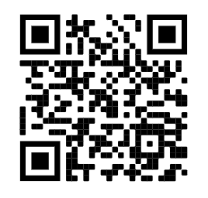
Q & A

Slide 11
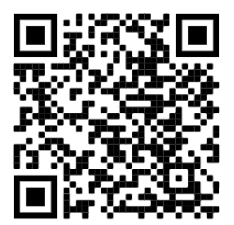
Contact info: aaleali@houstonisd.org
Algebra 1 Syllabus
Math 7 Syllabus
Q & R

